Slide 1



Sipna College of Engineering and Technology, Amravati. Department of Computer Science & Engineering
Subject : Object oriented Programming (Java)
Unit VI: Event Handling

Slide 2
Abstract Window Toolkit (AWT) is an API to develop GUI or window –
based applications in java.
A graphical user interface is built of graphical elements called components. Typical components include such items as buttons, scrollbars, and text fields.
Java AWT Components are platform dependent that is components are
displayed according to the view of operating system.
The Container class is a subclass of Component. Container class used to display non-container class.
In java GUI can be design using some predefined classes. All these classes are defined in java.awt package.

Slide 3
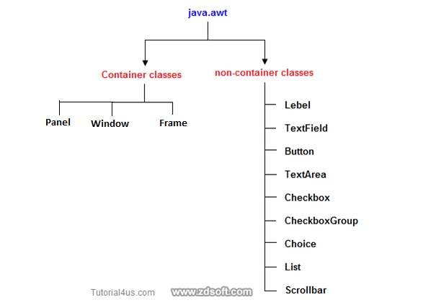
Awt class
The AWT provides nine basic non-container component and three container classes.

Slide 4
Unit VI: EVENT HANDLING
Introduction
Event delegation Model
java.awt.event Description
Sources of events
Event Listeners
Adapter Classes
Inner Classes
Abstract Window Toolkit

Slide 5
Introduction
What is Event?
Event is the change in the state of object or source.
What is Event Handling?
Event Handling is the mechanism that Controls the event and decides what should happen if an event occurs.
Event handling is at the core of successful applet programming. Most events to which the applet will respond are generated by the user.
The most commonly handled events are those generated by the mouse, the keyboard, and various controls, such as a push button.
Events are supported by the java.awt.event package.

Slide 6
The Delegation Event Model
Delegation Event Model
Source Listener
Is an object on Event handler generates
which event occurs. response to event.
Register
State Change
Event Occur
Java Code
Click Here
Display MSG

Slide 7
The modern approach to handling events is based on the delegation event model, which defines standard and consistent mechanisms to generate and process events.
Its concept is quite simple: a source generates an event and sends it to one or more listeners. In this scheme, the listener simply waits until it receives an event. Once received, the listener processes the event and then returns.
The advantage of this design is that the application logic that processes events (Event Handler logic)is cleanly separated from the user interface logic that generates those events. A user interface element is able to "delegate" the processing of an event to a separate piece of code.
In the delegation event model, listeners must register with a source in order to receive an event notification. This provides an important benefit: notifications are sent only to listeners that want to receive them.

Slide 8
EVENTS:
In the delegation model, an event is an object that describes a state change in a source. It can be generated as a consequence of a person interacting with the elements in a graphical user interface.
EVENT SOURCES:
A source is an object that generates an event. This occurs when the internal state of that object changes in some way. Sources may generate more than one type of event. A source must register listeners in order for the listeners to receive notifications about a specific type of event. Each type of event has its own registration method.
Here is the general form:
public void add Type Listener( Type Listener el )

Slide 9
EVENT LISTENERS:
A listener is an object that is notified when an event occurs.
It has two major requirements.
1st , it must have been registered with one or more sources to receive notifications about specific types of events.
2nd , it must implement methods to receive and process these notifications. The methods that receive and process events are defined in a set of interfaces found in java.awt.event.
For example:
The MouseMotionListener interface defines two methods to receive notifications when the mouse is dragged or moved.

Slide 10
There are three concepts related to Event Handling
1. Event Handler is the method that actually handles a registered event .Its acts as an actuator. A component for performing an action.
2. Event Listener is an interface in the View class that contains a method for calling event handler when an event occurs It acts as a sensor for detecting events.
3. Event Listeners Registration involves linking an event Listener to a user input control (e.g. a button)so that the event handler will be called when the user performs an action on the control.

Slide 11
java.awt.event Description
The java.awt.event package provides interfaces and classes for dealing with different types of events fired by AWT components.
EVENT CLASSES:
At the root of the Java event class hierarchy is EventObject, which is in java.util. It is the superclass for all events.
It’s one constructor is shown here:
EventObject(Object src)

Slide 12
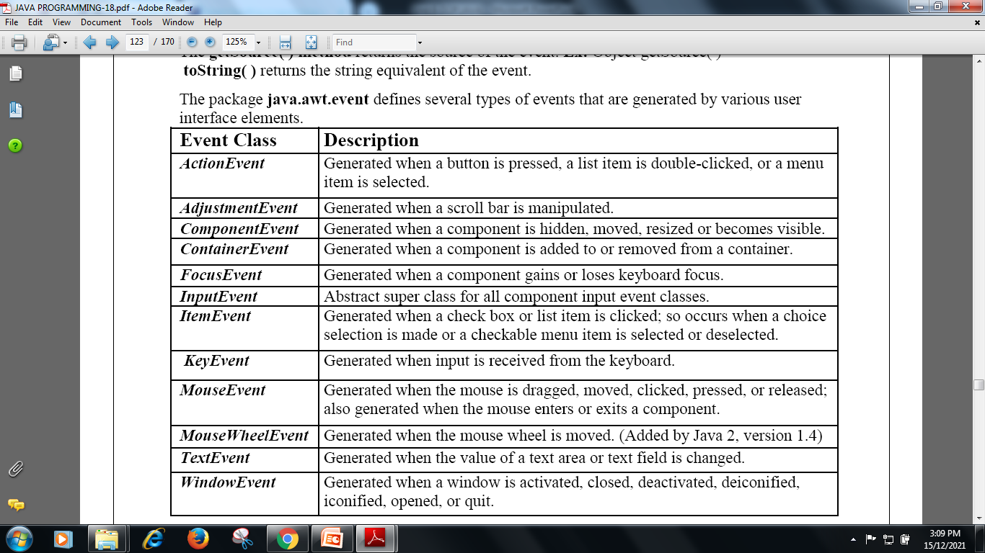
The package java.awt.event defines several types of events that are generated by various user interface elements.

Slide 13
1.The ActionEvent Class:
An ActionEvent is generated when a button is pressed, a list item is double-clicked, or a menu item is selected.
ActionEvent has these three constructors:
ActionEvent(Object src ,int type ,String cmd)
ActionEvent(Object src ,int type ,String cmd ,int modifiers)
ActionEvent(Object src ,int type ,String cmd ,long when ,int modifiers )

Slide 14
2.The ComponentEvent Class:
Component Event is generated when the size, position, or visibility of a component is changed.
There are four types of component events. The constants and their meanings are shown here:
COMPONENT_HIDDEN The component was hidden.
COMPONENT_MOVED The component was moved.
COMPONENT_RESIZED The component was resized.
COMPONENT_SHOWN The component became visible.

Slide 15
3. The ContainerEvent Class:
ContainerEvent is generated when a component is added to or removed from a container.
There are two types of container events.
COMPONENT_ADDED and
COMPONENT_REMOVED
4. The KeyEvent Class:
KeyEvent is generated when keyboard input occurs.
There are three types of key events, which are identified by these integer constants:
KEY_PRESSED
KEY_RELEASED
KEY_TYPED
event occurs when any key is pressed or released.
event occurs only when a character is generated.

Slide 16
5. The MouseEvent Class:
There are eight types of mouse events.
The MouseEvent class defines the following integer constants that can be used to identify them:
MOUSE_CLICKED The user clicked the mouse.
MOUSE_DRAGGED The user dragged the mouse.
MOUSE_ENTERED The mouse entered a component.
MOUSE_EXITED The mouse exited from a component.
MOUSE_MOVED The mouse moved.
MOUSE_PRESSED The mouse was pressed.
MOUSE_RELEASED The mouse was released.
MOUSE_WHEEL The mouse wheel was moved.

Slide 17
6. The WindowEvent Class:
There are ten types of window events.
The WindowEvent class defines integer constants that can be used to identify them. The constants and their meanings are shown here:
WINDOW_ACTIVATED The window was activated.
WINDOW_CLOSED The window has been closed.
WINDOW_CLOSING The user requested that the window be closed.
WINDOW_DEACTIVATED The window was deactivated.
WINDOW_DEICONIFIED The window was deiconified.
WINDOW_GAINED_FOCUS The window gained input focus.
WINDOW_ICONIFIED The window was iconified.
WINDOW_LOST_FOCUS The window lost input focus.
WINDOW_OPENED The window was opened.
WINDOW_STATE_CHANGED The state of the window changed.

Slide 18
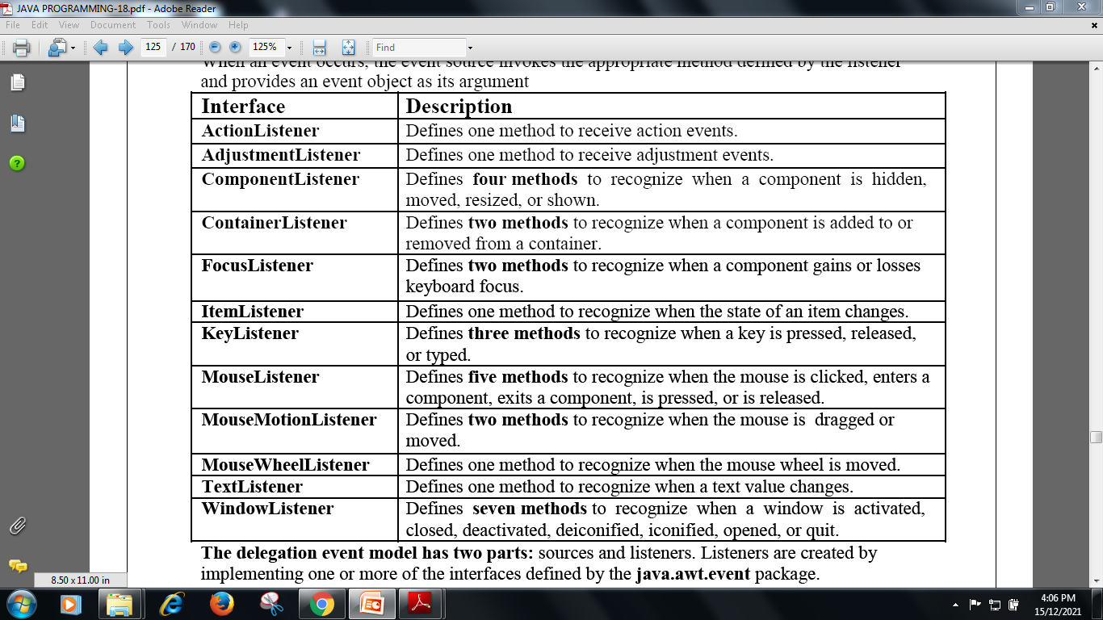
EVENT LISTENER INTERFACES
When an event occurs, the event source invokes the appropriate method defined by the listener and provides an event object as its argument

Slide 19
1. The ActionListener Interface:
This interface defines the actionPerformed( ) method that is invoked when an action event occurs.
Its general form is shown here:
void actionPerformed(ActionEvent e )
2. The AdjustmentListener Interface:
This interface defines the adjustmentValueChanged( ) method that is invoked when an adjustment event occurs.
Its general form is shown here:
void adjustmentValueChanged(AdjustmentEvent e)

Slide 20
3. The ComponentListener Interface:
This interface has four methods, having signatures as follows:
void componentResized(ComponentEvent e)
void componentMoved(ComponentEvent e)
void componentHidden(ComponentEvent e)
void componentShown(ComponentEvent e)
4. The ContainerListener Interface:
This interface has two methods defined in it. They are
void componentAdded(ContainerEvent e)
void componentRemoved(ContainerEvent e)

Slide 21
5. The FocusListener Interface:
This interface has two methods, having signatures as follows:
void focusGained(FocusEvent e)
void focusLost(FocusEvent e)
focusGained() is invoked when the component obtains keyboard focus and foucsLost() is invoked when the component loses the keyboard focus.
6. The ItemListener Interface:
This interface has only one methods defined as,
void itemStateChanged(ItemEvent e)
itemStateChanged() is invoked when the state of the item changes.

Slide 22
7. The KeyListener Interface:
This interface has three methods defined within it:
void keyPressed(KeyEvent e)
void keyReleased(KeyEvent e)
void keyTyped(KeyEvent e)
8. The MouseListener Interface:
This interface has five methods, having the signatures as followings:
void mouseClicked(MouseEvent e)
void mouseEntered(MouseEvent e)
void mousePressed(MouseEvent e)
void mouseReleased(MouseEvent e)
void mouseExited(MouseEvent e)

Slide 23
9. The MouseMotionListener Interface:
This interface has two methods, having the signatures as followings:
void mouseMoved(MouseEvent e)
void mouseDragged(MouseEvent e)
mouseMove() is invoked when the mouse is moved from one place to another and mouseDragged() is used when the mouse is dragged.
10. The MouseWheelListener Interface:
This interface has only one methods defined as,
void mouseWheelmoved(MouseEvent e)
mouseWheelmoved() is invoked when the mouse wheel is moved.

Slide 24
11. The TextListener Interface:
This interface has only one methods defined as,
void textChanged(TextEvent e)
This method is invoked whenever there is a change in text field or text area.
12. The WindowListener Interface:
This interface has seven methods defined as,
void windowActivated(WindowEvent e)
void windowClosed(WindowEvent e)
void windowClosing(WindowEvent e)
void windowOpened(WindowEvent e)
void windowDeactivated(WindowEvent e)
void windowIconified(WindowEvent e)
void windowDeiconified(WindowEvent e)

Slide 25
Program to demonstrate the mouse event handlers
/*<applet code="Mouse" width=600 height=500></applet>*/
import java.awt.*;
import java.applet.*;
import java.awt.event.*;
public class Mouse extends Applet implements MouseListener, MouseMotionListener
{
int x=60, y=60;
String msg="Mouse Event";
public void init()
{
addMouseListener(this);
addMouseMotionListener(this);
setBackground(Color.black);
setForeground(Color.white);
}

Slide 26
public void mouseEntered(MouseEvent e)
{
msg="Mouse Entered";
setBackground(Color.magenta);
showStatus("Mouse Entered");
repaint();
}
public void mouseExited(MouseEvent e)
{
msg="Mouse Exited";
setBackground(Color.red);
showStatus("Mouse Exited");
repaint();
}

Slide 27
public void mouseMoved(MouseEvent e)
{
x=e.getX();
y=e.getY();
msg="Mouse Moved";
setBackground(Color.blue);
showStatus("Mouse Moved");
repaint();
}
public void mouseDragged(MouseEvent e)
{
msg="Mouse Dragged";
setBackground(Color.pink);
showStatus("Mouse Dragged at("+e.getX()+","+e.getY()+")");
repaint();
}
public void paint(Graphics g)
{
Font f=new Font("Arial",3,50);
g.setFont(f);
g.drawString(msg,x,y);
}
}

Slide 28
public void mousePressed(MouseEvent e)
{
msg="Mouse Pressed";
setBackground(Color.yellow);
showStatus("Mouse Pressed");
repaint();
}
public void mouseReleased(MouseEvent e)
{
msg="Mouse Released";
setBackground(Color.green);
showStatus("Mouse Released");
repaint();
}
public void mouseClicked(MouseEvent e)
{
msg="Mouse Clicked";
setBackground(Color.gray);
showStatus("Mouse Clicked");
repaint();
}

Slide 29
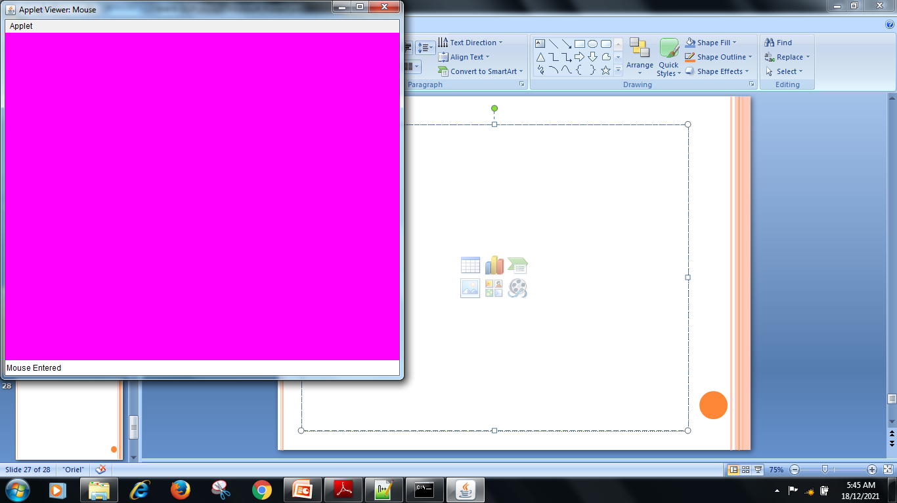
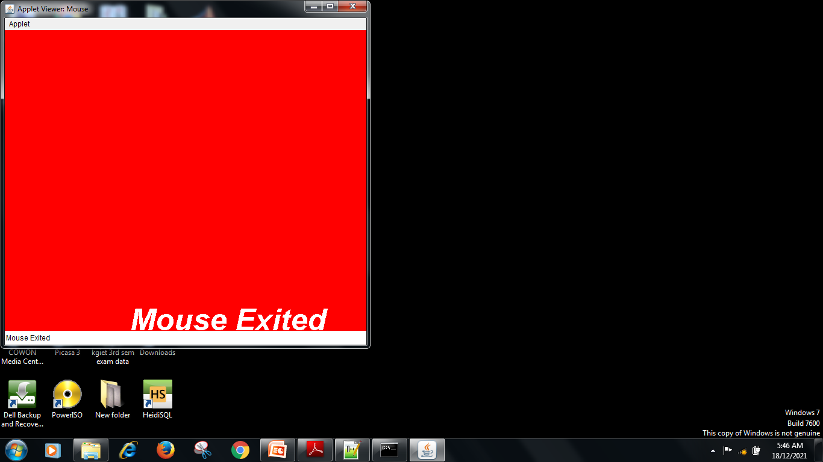
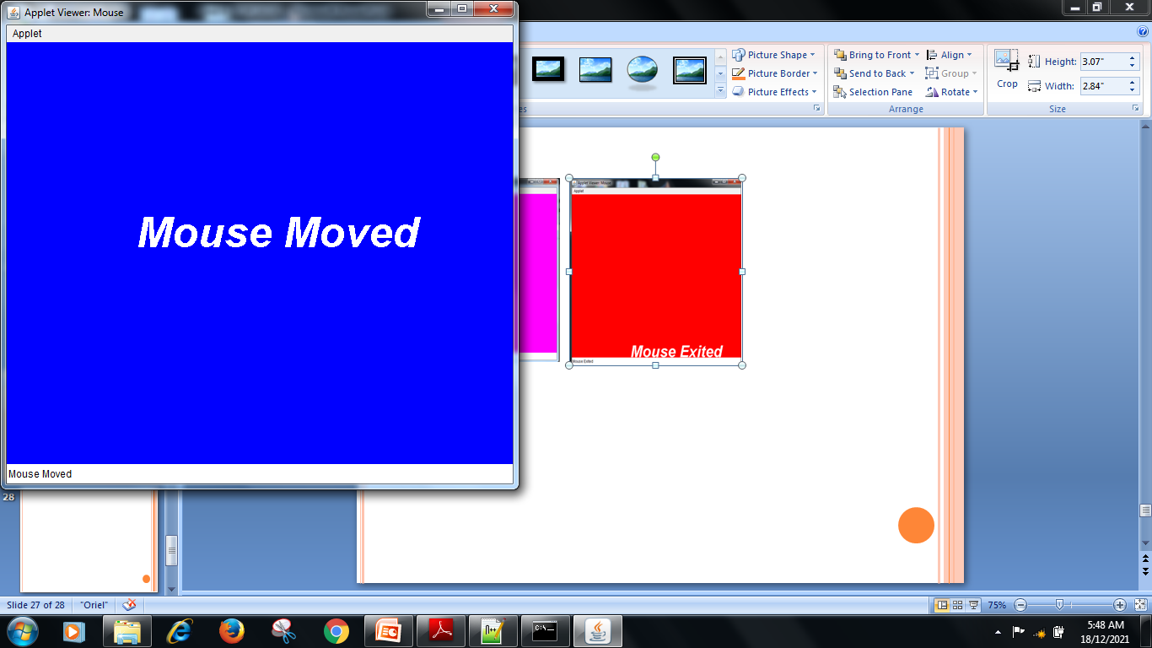
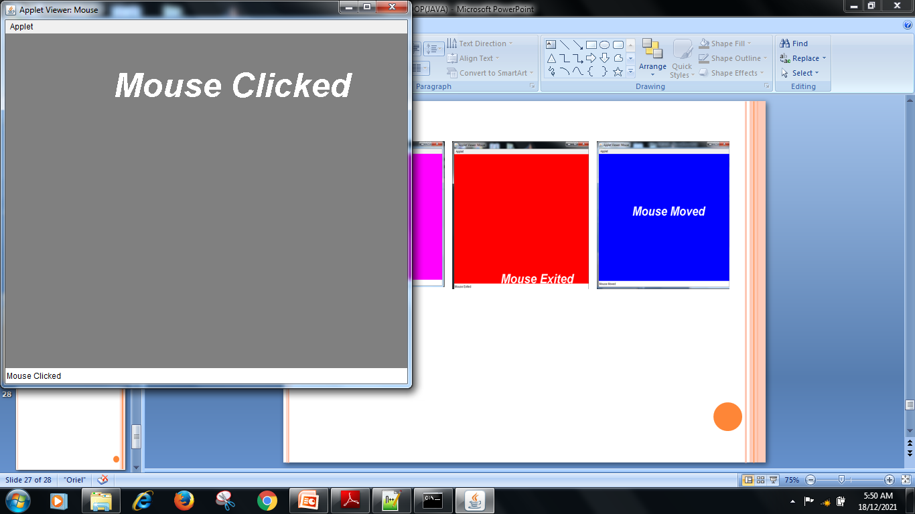
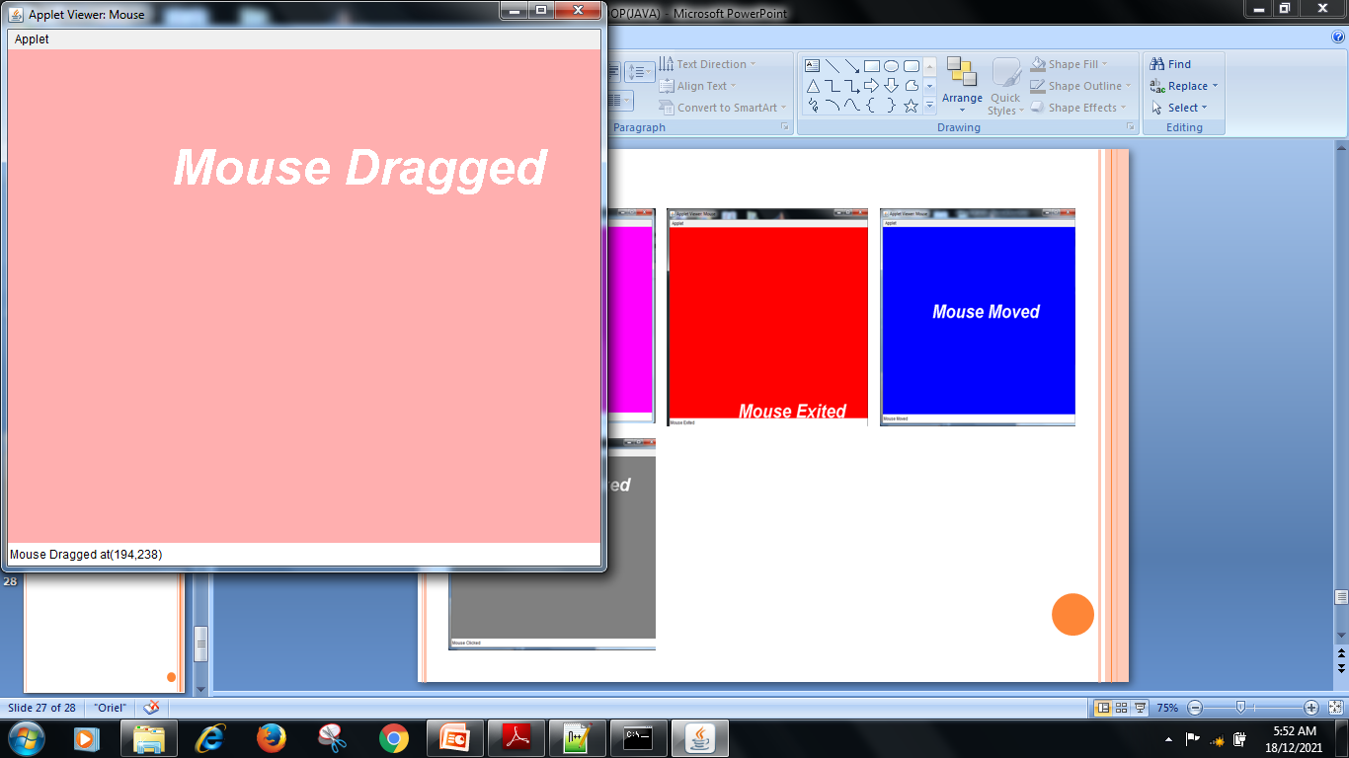
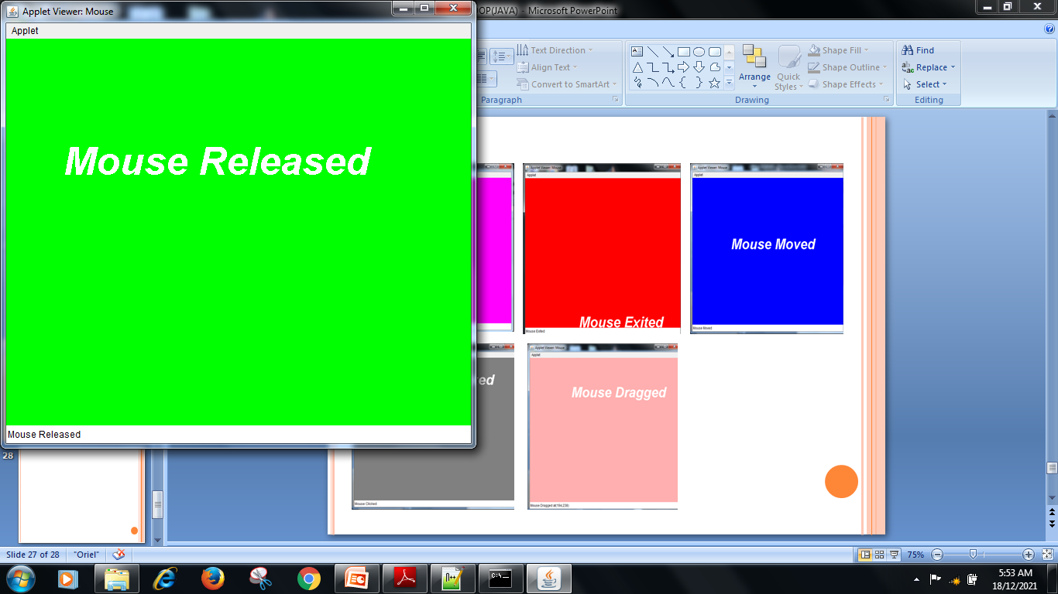
OUTPUT:

Slide 30
Program to demonstrate the key event handlers
/*<applet code="Key" width=600 height=300></applet>*/
import java.awt.*;
import java.applet.*;
import java.awt.event.*;
public class Key extends Applet implements KeyListener
{
int x=30, y=60;
String msg="";
public void init()
{
addKeyListener(this);
setBackground(Color.magenta);
setForeground(Color.black);
}

Slide 31
public void keyPressed(KeyEvent e)
{
setBackground(Color.yellow);
showStatus("Key Down");
repaint();
}
public void keyReleased(KeyEvent e)
{
setBackground(Color.red);
showStatus("Key Up");
repaint();
}
public void keyTyped(KeyEvent e)
{
msg+=e.getKeyChar();
repaint();
}
public void paint(Graphics g)
{
Font f=new Font("TimesRoman",2,40);
g.setFont(f);
g.drawString(msg,x,y);
}}

Slide 32
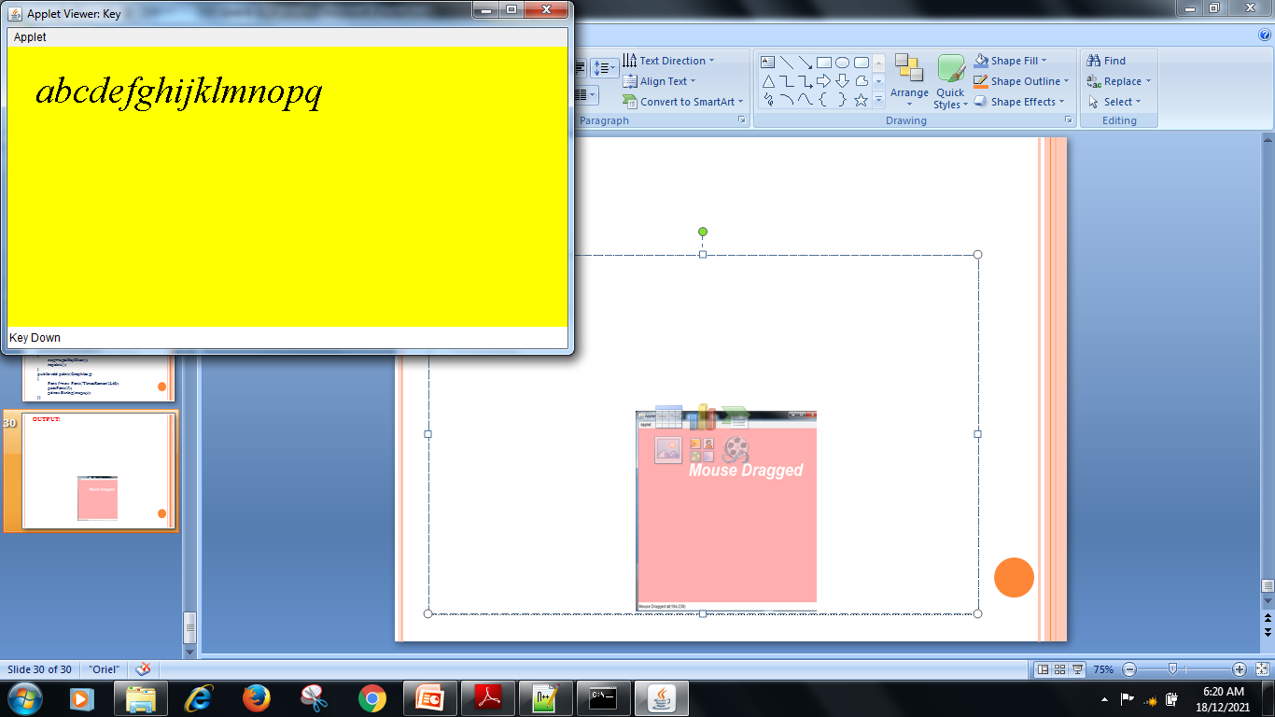
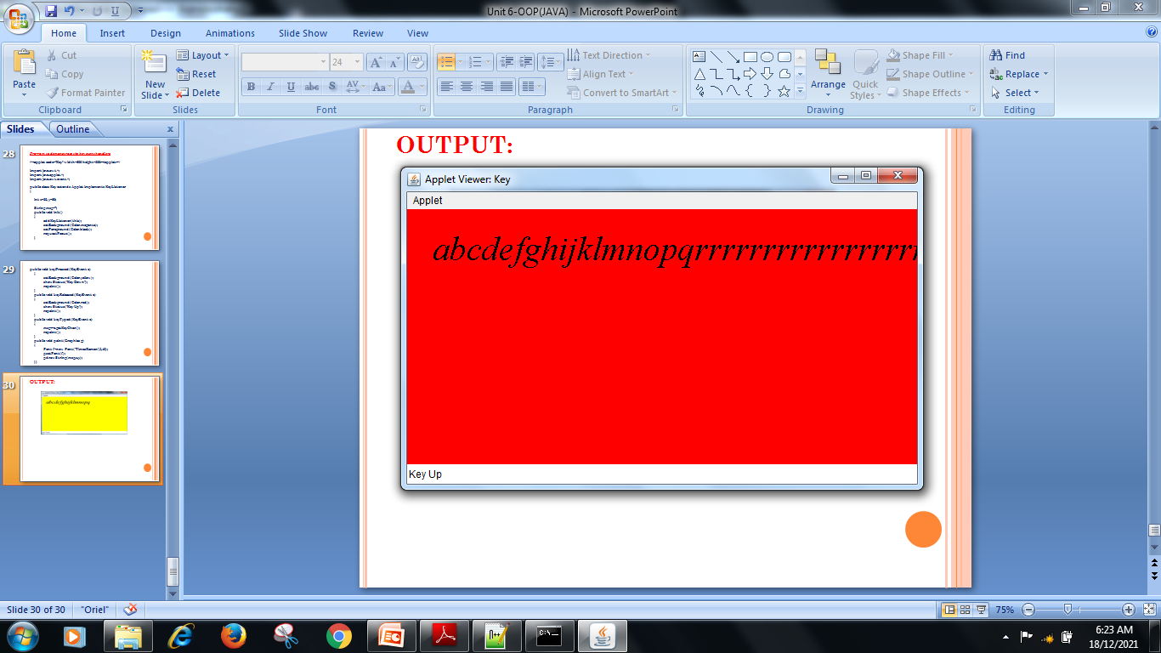
OUTPUT:

Slide 33
Adapter Classes:
Java provides a special feature, called an adapter class, that can simplify the creation of event handlers.
An adapter class provides an empty implementation of all methods in an event listener interface.
For Eg. the MouseMotionAdapter class has two methods, mouseDragged( ) and mouseMoved( ), which are the methods defined by the MouseMotionListener interface.
Define a new class to act as an event listener by extending one of the adapter classes and implementing only those events in which you are interested.

Slide 34
If only mouse drag events is to be used, simply extend MouseMotionAdapter and override mouseDragged( ).
The adapter classes are predefined and available in java.awt.event package.

Slide 35
Adapter classes in Java:
Listener Interface | Adapter Classes | Registration Methods
ComponentListener | ComponentAdapter | addComponentListener
ContainerListener | ContainerAdapter | addContainerListener
FocusListener | FocusAdapter | addFocusListener
KeyListener | KeyAdapter | addKeyListener
MouseListener | MouseAdapter | addMouseListener
MouseMotionListener | MouseMotionAdapter | addMouseMotionListener
WindowListener | WindowAdapter | addWindowListener

Slide 36
Inner Classes:
Class declared within another class or even within an expression.
Why use inner classes?
Help simplify your program
Especially in event handling
There can be 3 categories of inner classes:
Member classes
Local classes
Anonymous classes

Slide 37
Member Classes:
These classes are included in the class definition just like variables and methods. A member class can either be static or instance.
Static Member Class
Instance Member Class
Local Classes:
A local class is defined within a code block, typically in a method.
Anonymous Classes:
Anonymous inner class is one that is not assigned a name and this class is not reusable.

Slide 38
Abstract Window Toolkit
The Abstract Window Toolkit(AWT) was Java’s first GUI frame work. (Others are Swing and javaFX )
AWT is used to create both Applets and stand alone GUI based programs
AWT Components are Platform Dependant.
The AWT classes are contained in the java.awt package.

Slide 39
Few AWT Classes:
Class Description
AWTEvent The root event class for all AWT events
AWTEventMulticaster Dispatches events to multiple listeners.
BorderLayout The border layout manager.
Border layouts use five components: North, South, East, West, and Center.
Button Creates a push button control.
Canvas A blank, semantics-free window.
CardLayout The card layout manager. Card layouts emulate index cards. Only the one on top is showing.
Checkbox Creates a check box control.
CheckboxGroup Creates a group of check box controls.

Slide 40
Few AWT Classes:
Class Description
Choice Creates a pop-up list.
Color Manages colors in a portable, platform- independent fashion.
Component An abstract superclass for various AWT components.
Container A subclass of Component that can hold other components.
Cursor Encapsulates a bitmapped cursor.
Dialog Creates a dialog window.
Dimension Specifies the dimensions of an object. The width is stored in width, and the height is stored in height.
EventQueue Queues events.
FileDialog Creates a window from which a file can be selected.

Slide 41
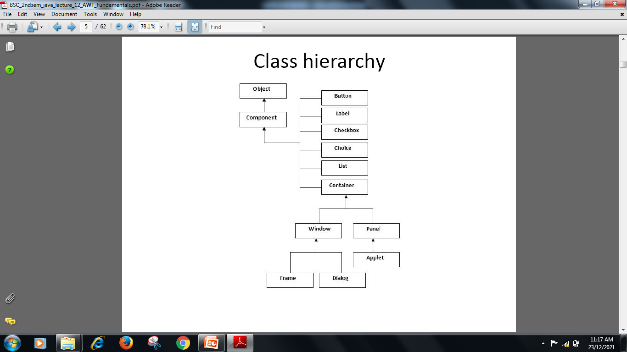
Hierarchy of Classes in AWT

Slide 42
Components and Container
At the top of the AWT hierarchy is the Component class.
Component is an abstract class that encapsulates all of the attributes of a visual component.
The Container class is a subclass of Component.
It has additional methods that allow other Component objects to be nested with in it. Other Container objects can be stored inside of a Container

Slide 43
Container class:
Window Class:
The window is the container that have no borders and menu bars. You must use frame, dialog or another window for creating a window.
Frame Class:
The Frame is the container that contain title bar and can have menu bars. It can have other components like button, text field etc.
Panel Class:
The Panel is the container that doesn't contain title bar and menu bars. It can have other components like button, text field and etc.
Canvas Class:
It represents a rectangular area where application can draw something or can receive inputs created by user.
Note:
Before adding the components that make up a user interface, the programmer must create a container.

Slide 44
Creating the Frame:
Frames are used to create standard application windows.
Two Frame’s constructors are:
Frame( ) //Create a blank Frame object without title.
Frame(String title) //Create a Frame object with title.
The dimensions of the window is set after it has been created using setSize() method.
void setSize(int newWidth, int newHeight)
void setSize(Dimension newSize)
The new size of the window is specified by newWidth and newHeight, or by the width and height fields of the Dimension object passed in newSize. The dimensions are specified interms of pixels.
Dimension newSize=new Dimension(400,400);

Slide 45
Frame Class Methods:
Methods | Description
void setTitle(String title) | It is used to set title of Frame object.
String getTitle() | It returns the title of the Frame.
setMenuBar(MenuBar mb) | It is used to attach MenuBar object.
void setResizable(Boolean b) | It creates resizable of fixed window.
void setSize(int w, int h) | Sets the size of the window.
void setVisible(boolean flag) | It shows or hides the window.

Slide 46
AWT CONTROLS:
AWT Supports the following types of controls.
Label
Button
Check box
Check box Group
Choice list
List
Scroll bar
Text box
Text area
To add controls you must create an window and add by following method.
add(ComponentObj);
To remove call the following method
void remove(ComponentObj);

Slide 47
LABEL:
Labels do not generate any event.
This component can be used for displaying a single line of text in a container
The following constructor used to create the Label
Constructor | Description
Label() | Constructs as an empty label.
Label(String text) | Constructs a string with corresponding text.
Label(String text, int alignment) | Constructs a string with the text, with the specified alignment. The alignment can be CENTER, LEFT, RIGHT.

Slide 48
LABEL:
Methods
Methods | Description
String getText() | Gets the text of the corresponding label.
void setText(String text) | Sets the text for the corresponding label to the specified text.

Slide 49
BUTTON:
Button are components that can contain a label. Button is similar to a push button in any other GUI.
When a button is pressed, it notifies its Listeners.
The following constructor used to create the Button
Constructor | Description
Button() | Constructs a button with no label.
Button(String text) | Constructs a button with the label specified.

Slide 50
button:
Interface : ActionListener
Method: public void actionPerformed(ActionEvent e)
Class : ActionEvent
Method: String getActionCommand() // Returns the label of the button which has generated the event.
Object getSource() // It returns the reference of the button which has generated the event.
Methods | Description
String getLabel() | Returns the label of the corresponding button.
void setLabel(String text) | Set label of button to the value Specified.
void addActionListener(ActionListener al) | Adds specified action listener to receive action events from corresponding button.

Slide 51
//Program to check which button is clicked using getSource( ) method.
/*<applet code="ButtonClass" width=300 height=300></applet>*/
import java.awt.*;
import java.applet.*;
import java.awt.event.*;
public class ButtonClass extends Applet implements ActionListener
{
Button b1,b2,b3;
Label l1;
public void init()
{
b1=new Button("Red");
b2=new Button("Green");
b3=new Button("Blue");
l1=new Label("Hit a button to change the screen color");
add(b1);
add(b2);
add(b3);
add(l1);
b1.addActionListener(this);
b2.addActionListener(this);
b3.addActionListener(this);
}

Slide 52
public void actionPerformed(ActionEvent ae)
{
Button bs=(Button)ae.getSource();
if(bs==b1)
{
setBackground(Color.red);
}
else if(bs==b2)
{
setBackground(Color.green);
}
else if(bs==b3)
{
setBackground(Color.blue);
}
repaint();
}
}

Slide 53
//Program to check which button is clicked using getActionCommand( ) method.
/*<applet code="ButtonClass" width=300 height=300></applet>*/
import java.awt.*;
import java.applet.*;
import java.awt.event.*;
public class ButtonClass extends Applet implements ActionListener
{
Button b1,b2,b3;
Label l1;
public void init()
{
b1=new Button("Red");
b2=new Button("Green");
b3=new Button("Blue");
l1=new Label("Hit a button to change the screen color");
add(b1);
add(b2);
add(b3);
add(l1);
b1.addActionListener(this);
b2.addActionListener(this);
b3.addActionListener(this);
}

Slide 54
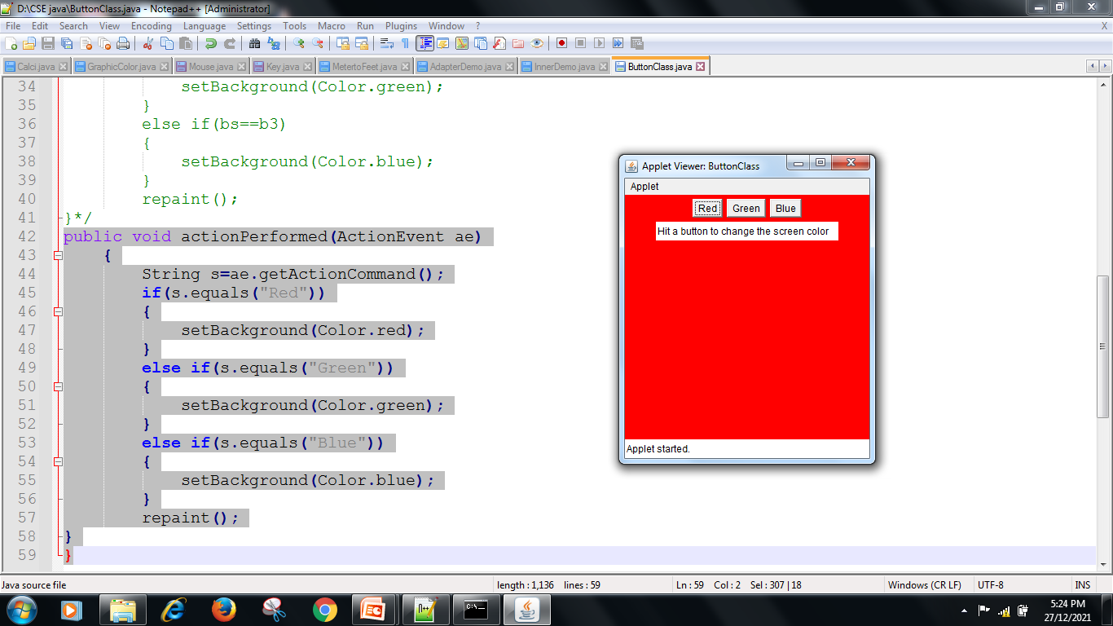
public void actionPerformed(ActionEvent ae)
{
String s=ae.getActionCommand();
if(s.equals("Red"))
{
setBackground(Color.red);
}
else if(s.equals("Green"))
{
setBackground(Color.green);
}
else if(s.equals("Blue"))
{
setBackground(Color.blue); OUTPUT:
}
repaint();
}
}

Slide 55
List:
This class is a Component which displays a list of Strings.
The list is scrollable, if necessary.
Sometimes called Listbox in other languages.
Lists can be constructed to allow single or multiple selections.
The list will return an array indicating which Strings are selected
Constructor | Description
List() | Create a new scrolling list of items
List(int visibleitems) | Create a new scrolling list of items with specified number of visible items.
Label(int visibleitems, boolean multimode) | Create a new scrolling list of items to display the specified number of visibleitems (multimode can be true or false).

Slide 56
List:
Methods | Description
void add(String item) | Add the specified item to the end of the scrolling list
void add(String item, int index) | Add the specified item at the position.
String getItem(int index) | Gets the item at the specified index
int getItemCount() | Gets the no. of items in the list.
String[] getItems() | Gets the items in the list.
int getSelectedIndex() | Gets the index of selected item in the list.
String getSelectedIndex() | Gets the selected item in the list.
void setMultipleMode(boolean b) | Sets the flag that allows multiple selection
void select(int index) | Selects the item at the specified index.
void remove(int index), void remove(String item), void removeAll() | Remove the item at specified index and remove specified item and remove all the item in the list.

Slide 57
// importing awt class
import java.awt.*;
public class ListExample1
{
// class constructor
ListExample1() {
// creating the frame
Frame f = new Frame();
// creating the list of 5 rows
List l1 = new List(5);
// setting the position of list component
l1.setBounds(100, 100, 75, 75);
// adding list items into the list
l1.add("Item 1");
l1.add("Item 2");
l1.add("Item 3");
l1.add("Item 4");
l1.add("Item 5");

Slide 58
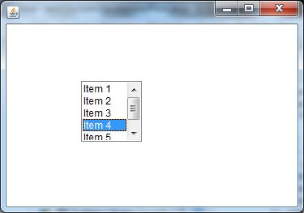
// adding the list to frame
f.add(l1);
// setting size, layout and visibility of frame
f.setSize(400, 400);
f.setLayout(null);
f.setVisible(true);
}
// main method
public static void main(String args[])
{
new ListExample1();
}
}

Slide 59
Choice:
This class represents a dropdown list of Strings.
Similar to a list in terms of functionality, but displayed differently.
Only one item from the list can be selected at one time and the currently selected element is displayed.
Constructor | Description
Choice() | Create a new choice menu.

Slide 60
Choice:
Methods | Description
void add(String item) | Adds an item to the corresponding choice menu.
void addItem(String item) | Adds an item to the corresponding choice.
String getItem(int index) | Gets the string at the specified index of the corresponding choice menu.
int getItemCount() | Returns the no. of items in the choice menu.
int getSelectedIndex() | Returns the index of the currently selected item.
String getSelectedIndex() | Gets a representation of the current choice as a string..
insert(String items, int index) | Insert the item into the corresponding choice at the specified position.
select(String str) | Selects the item in the corresponding choice menu.
void removeAll() | Remove all the item from the choice menu.

Slide 61
TextField:
TextFields are GUI components that accept text input from the user.
This class inherits several methods from TextComponent.
TextFields only have single line text.
Constructor | Description
TextField() | Constructs a new text field.
TextField(int columns) | Create a new text field with the specified number of columns.
TextField(String text) | Create a new text field initialized with the specified text.
TextField(String text, int columns) | Create a new text field initialized with the specified text with the specified number of columns.

Slide 62
TextField:
Methods | Description
int getColumns( ) | Gets the no. of columns in the corresponding text field.
char getEchoChar( ) | Gets the character that is to be used for echoing.
void setColumns(int columns) | Sets the no. of columns in the text field.
void setEchoChar(char c) | Sets the echo character for the text field.
void setText(String str) | Set the text.

Slide 63
TextArea:
TextAreas behave like TextFields except that they have more functionality to handle large amounts of text.
This class inherits several methods from TextComponent.
TextArea can contain multiple rows of text.
TextArea have scrolls that permit handling of large amounts of data
Constructor | Description
TextArea( ) | Constructs new text area.
TextArea(int rows, int columns) | Constructs new text area with specified no. of rows and columns.
TextArea(String text) | Constructs new text area with specified text.
TextArea(String text, int rows, int columns) | Constructs new text area with specified text and specified no. of rows and columns.
TextArea(String text, int rows, int columns, int scrollbar) | Constructs new text area with specified text and specified no. of rows and columns and visiblity of the scrollbar

Slide 64
TextArea:
Methods | Description
void append(String str) | Appends the given string to the text area’s content.
int getColumns( ) | Gets the no. of columns in the text area.
int getRows( ) | Gets the no. of rows in the text area.
void insert(String str, int pos) | Insert the specified string at the specified position.
void setColumns(int columns) | Sets the number of columns for the text area
void setRows(int rows) | Sets the number of rows for the text area

Slide 65
Checkbox:
This class is used to create checkbox type object.
The Checkbox maintains a boolean state indicating whether it is checked or not.
If a Checkbox is added to a CheckBoxGroup, it will behave like a radio button.
Constructor | Description
Checkbox() | It is used to create Checkbox without label.
Checkbox(String label) | It is used to create Checkbox with specified label.
Checkbox(String label, boolean state) | It is used to create Checkbox without label and state.(state can be true or false)
Checkbox(String label, CheckboxGroup g, boolean state ) | It is used to create radiobutton.

Slide 66
Checkbox:
Methods | Description
void setLabel(String label) | It is used to set label on Checkbox.
String getLabel( ) | It return the label of the Checkbox.
Boolean getState( ) | It return the state of the Checkbox.
setState(boolean b) | It is used to set state of the Checkbox.
public void addItemListener( ItemListener il) | This method tells the Checkbox to call a method “itemStateChanged” when checkbox state is changed.

Slide 67
// importing AWT class
import java.awt.*;
public class CheckboxExample1
{
CheckboxExample1() {
// creating the frame with the title
Frame f = new Frame("Checkbox Example");
// creating the checkboxes
Checkbox checkbox1 = new Checkbox("C++");
checkbox1.setBounds(100, 100, 50, 50);
Checkbox checkbox2 = new Checkbox("Java", true);
// setting location of checkbox in frame
checkbox2.setBounds(100, 150, 50, 50);

Slide 68
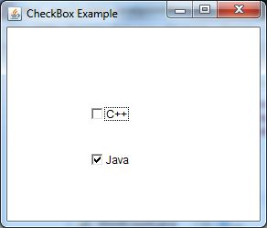
// adding checkboxes to frame
f.add(checkbox1);
f.add(checkbox2);
// setting size, layout and visibility of frame
f.setSize(400,400);
f.setLayout(null);
f.setVisible(true);
}
// main method
public static void main (String args[])
{
new CheckboxExample1();
}
}

Slide 69
LayoutManagers:
Every container has a LayoutManager attached with it.
Job of layoutManager is to arrange the components which are added in the container.
There are several different LayoutManagers, each of which sizes and positions its Components based on an algorithm:
FlowLayout
BorderLayout
GridLayout
For Window and Frames, the default LayoutManager is BorderLayout.
For Panels the default LayoutManager is FlowLayout.

Slide 70
FlowLayout:
The algorithm used by the FlowLayout is to layout components like words on a page: Left to right, top to bottom.
It fits as many Components into a given row before moving to the next row.
Gridlayout:
This LayoutManager arranges the components in a grid fashion. i.e. in rows and columns.
BorderLayout:
This LayoutManager arranges the components along the border and at the center of the container. While adding the component we have to specify the constraint where we want to add by calling method
add(Component c, Object Constraint)
Constraint can be any of the “North” “South” “East” “West” “Center”
ex:- Button b1=new Button(“Ok”);
add(b1, “North”);

Slide 71
MenuBar, Menu and MenuItem:
A menu bar displays a list of top-level menu choices
Each choice is associated with a drop-down menu
This concept is implemented in Java by the following classes
MenuBar
Menu
MenuItem

Slide 72
MenuBar:
This class is used to create MenuBar object.
Constructor | Description
MenuBar() | It will create a MenuBar object.
Methods | Description
void add(Menu m) | It will add specified menu in MenuBar Object.
void remove(int n) | It will remove menu from specified position.
int getMenuCount() | Return total no. of menu in MenuBar.

Slide 73
Menu:
This class is used to create pull down menu.
Constructor | Description
Menu(String label) | It will create a Menu object with specified label.
Methods | Description
add(MenuItem mi) | It will add MenuItem in menu.
void remove(int index) | It will remove menu at specified index.
int getItemCount() | Return total no. of MenuItem in MenuBar.
addSeperator() | It is used to separate menus.

Slide 74
MenuItem:
This class is used to create MenuItems which can be added into Menu.
Constructor | Description
MenuItem(String label) | Create menu item with given label.
Methods | Description
void addActionListener(Listener l) | This method tells MenuItem to call a special method actionPerformed when MenuItem is selected.
void setLabel(String label) | It is used to set label on MenuItem.

Slide 75
//Program to demonstrate use of Frame Class and Menu Class//
import java.awt.*;
public class FrameMenuDemo extends Frame
{
public FrameMenuDemo(String title)
{
super(title);
}
public static void main(String args[])
{
FrameMenuDemo fm=new FrameMenuDemo("Frame and MenuBar Demo");
MenuBar mb=new MenuBar();
Menu m=new Menu("File");
Menu m1=new Menu("Edit");
Menu m2=new Menu("View");

Slide 76
Menu sm=new Menu("Zoom");
MenuItem i1=new MenuItem("New");
MenuItem i2=new MenuItem("Open");
MenuItem i3=new MenuItem("Save");
MenuItem i4=new MenuItem("Undo");
MenuItem i5=new MenuItem("Cut");
MenuItem i6=new MenuItem("Paste");
MenuItem i7=new MenuItem("Zoom in");
MenuItem i8=new MenuItem("Zoom Out");

Slide 77
m.add(i1);
m.add(i2);
m.add(i3);
m1.add(i4);
m1.add(i5);
m1.add(i6);
sm.add(i7);
sm.add(i8);
m2.add(sm);
mb.add(m);
mb.add(m1);
mb.add(m2);
fm.setMenuBar(mb);
fm.setSize(400,400);
fm.setVisible(true);
}
}

Slide 78
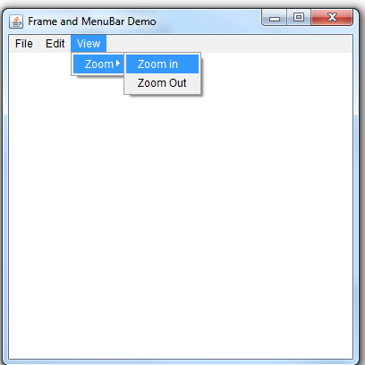
Output:

